Slide 1





FDTD Satellite Applications Webinar:
A Climatologically Rare November Morning Hailstorm in Southwest Lower Michigan: Using the Airmass RGB to Diagnose an Intense, Localized PV Intrusion
Presented by
TJ Turnage, Science and Operations Officer, NWS GRR
Grand Rapids Michigan
13 December 2023

Slide 2
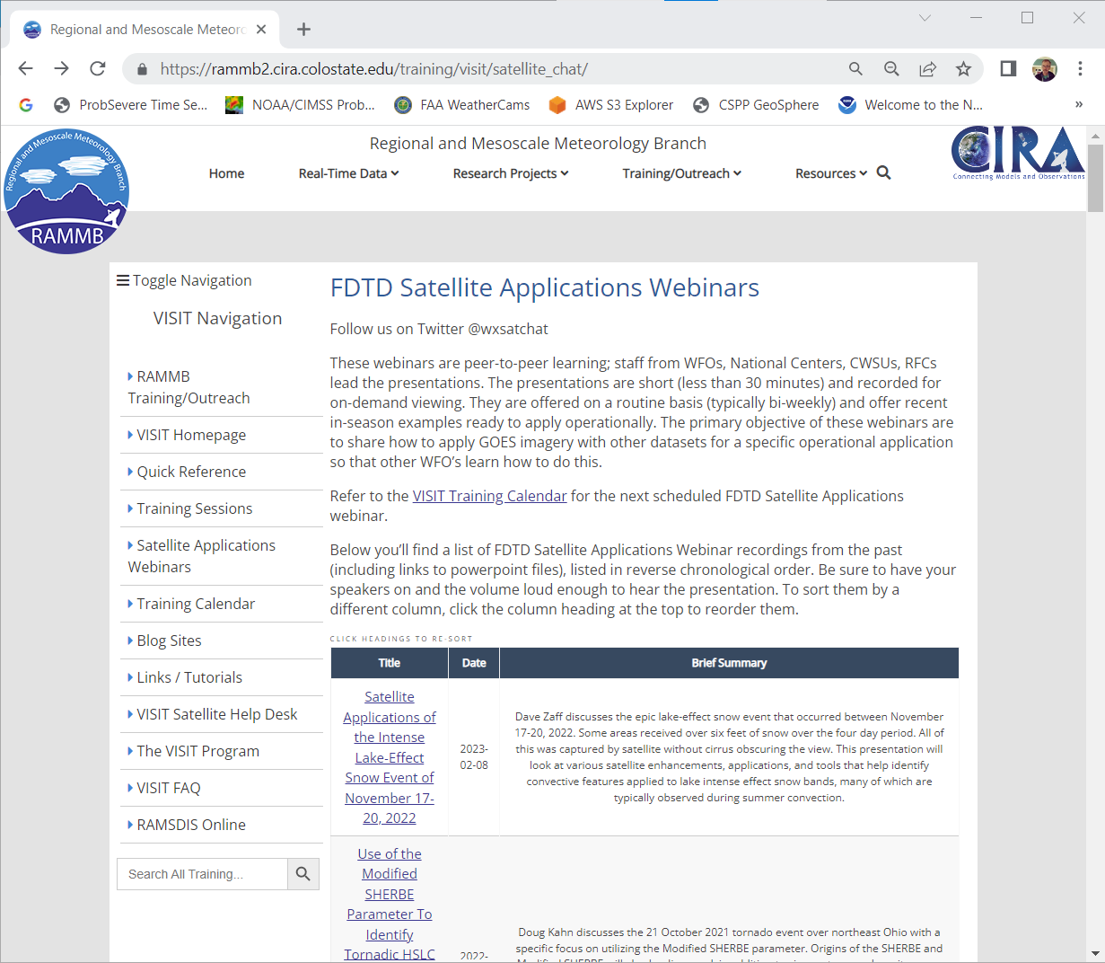
FDTD “Satellite Chat” Library
https://rammb2.cira.colostate.edu/training/visit/satellite_chat/ Recorded Content includes Q&A
Call for speakers! Let us know if you want to speak on a topic!
Contact: scott.lindstrom@noaa.gov OR dan.bikos@noaa.gov

Slide 3


FDTD Satellite Applications
Webinar Protocol
~20 minutes for the speaker
  Send questions via GoTo Chat
  Or ask during Q&A period via phone
Followed by Q&A
  Open discussion forum
  Done by 1830 UTC
Do NOT press hold!!!
Mute when not speaking

Slide 4
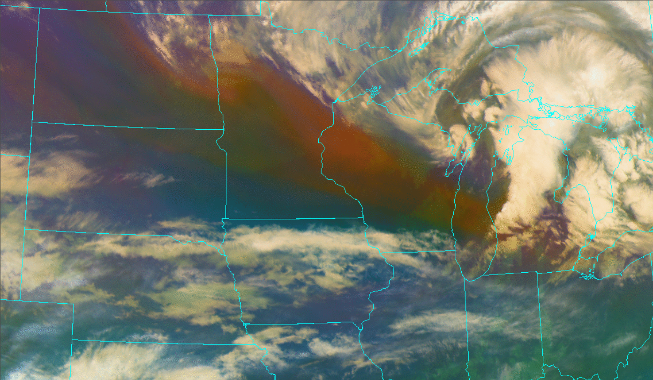
A Climatologically Rare November Morning Hailstorm in Southwest Lower Michigan: Using the Airmass RGB to Diagnose an Intense, Localized PV Intrusion
Thank you Scott Lindstrom for your assistance!
https://cimss.ssec.wisc.edu/satellite-blog/archives/55525

Slide 5
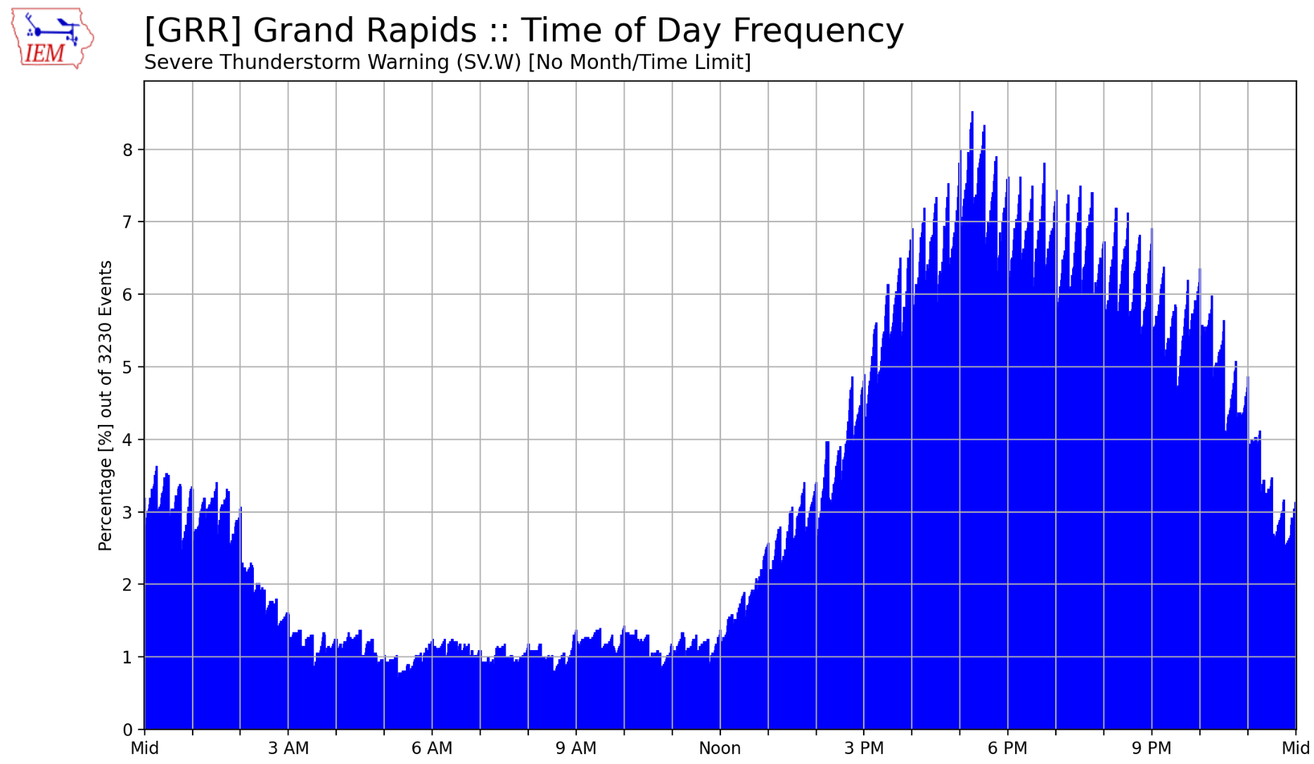
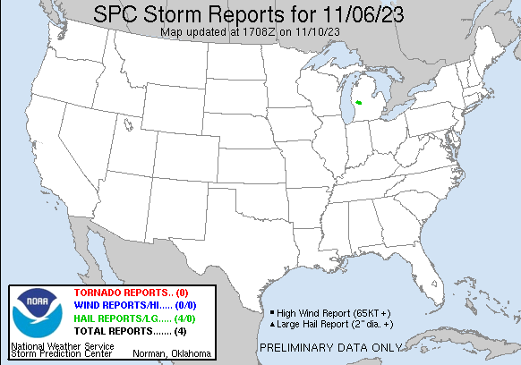
Just how rare was this event?
Percentage of Grand Rapids Severe Thunderstorm Warnings by time of day
Only other Michigan November severe hail report I could find …
1.00” on 11/17/2013

Slide 6
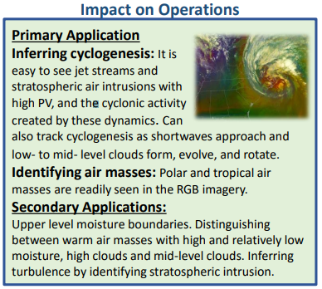
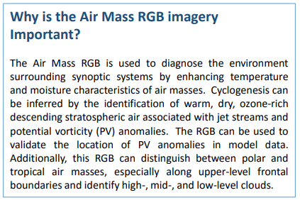
Just what is this Airmass RGB?
https://rammb.cira.colostate.edu/training/visit/quick_guides/QuickGuide_GOESR_AirMassRGB_final.pdf

Slide 7
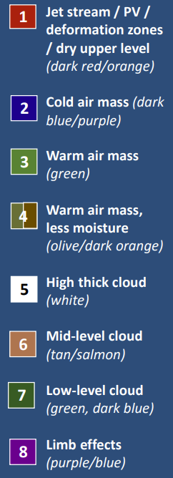
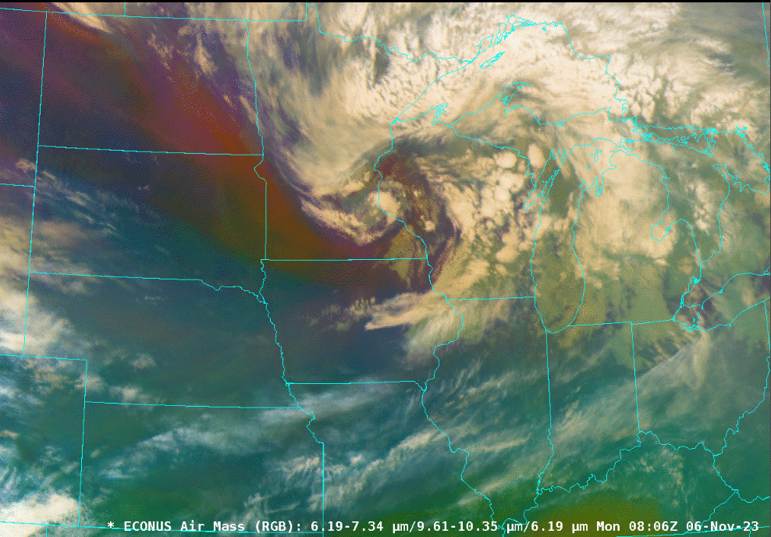
Airmass RGB Interpretation

Slide 8
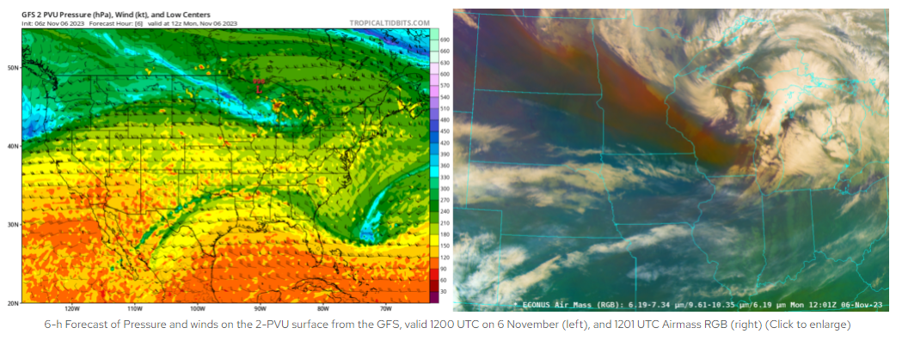
Airmass RGB relationship to PV intrusions
https://cimss.ssec.wisc.edu/satellite-blog/archives/55525

Slide 9
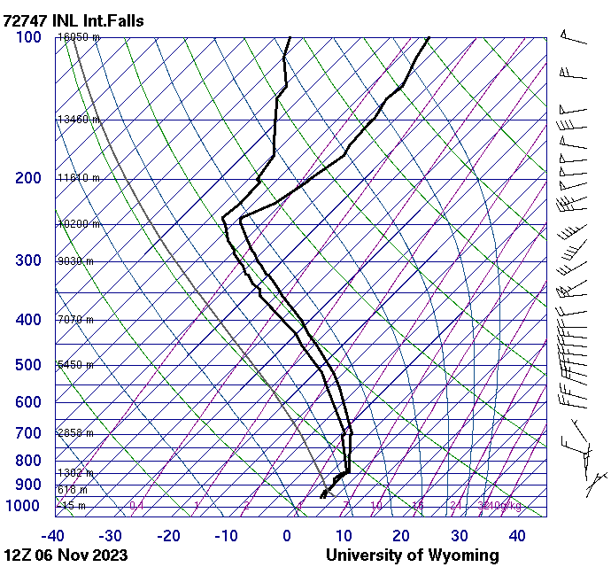
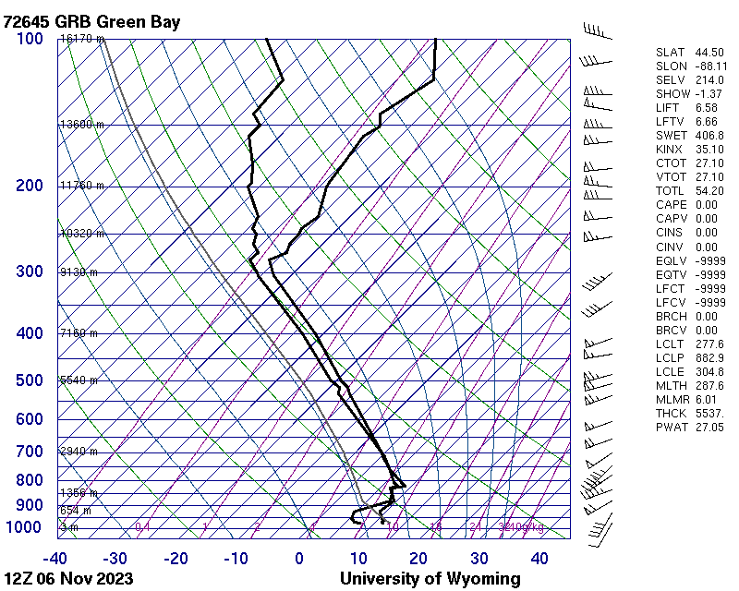
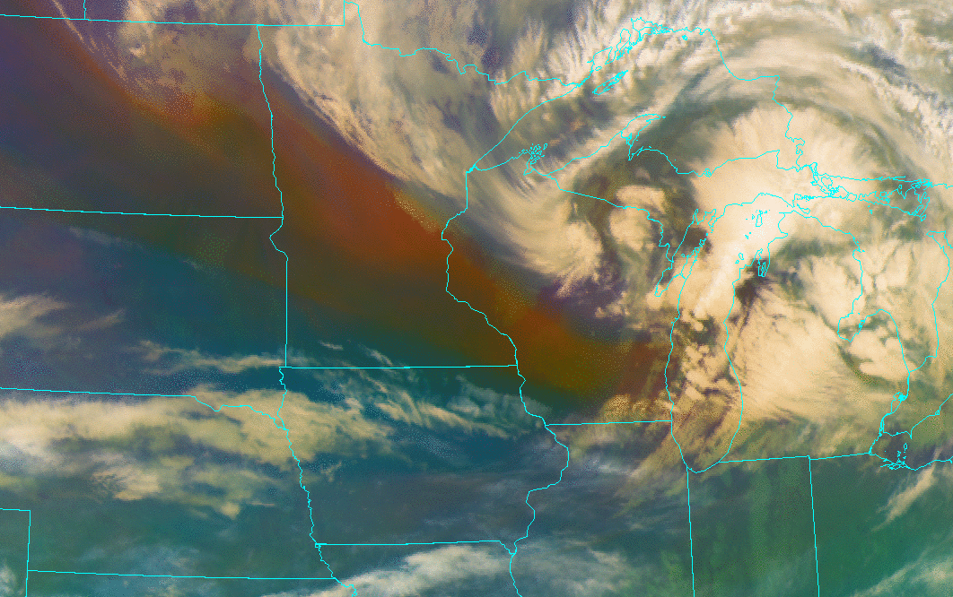
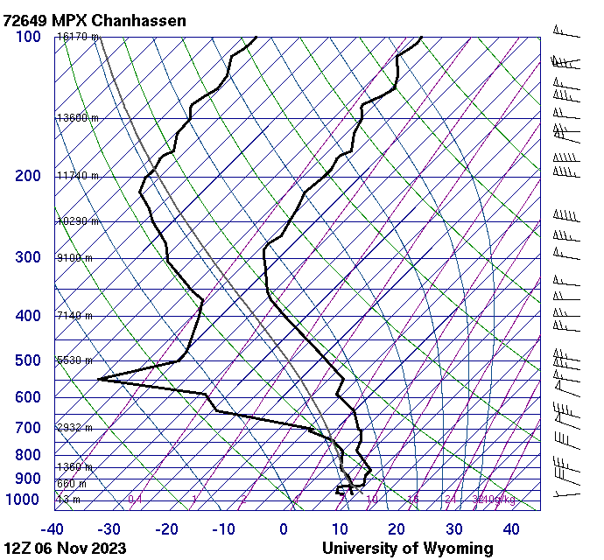
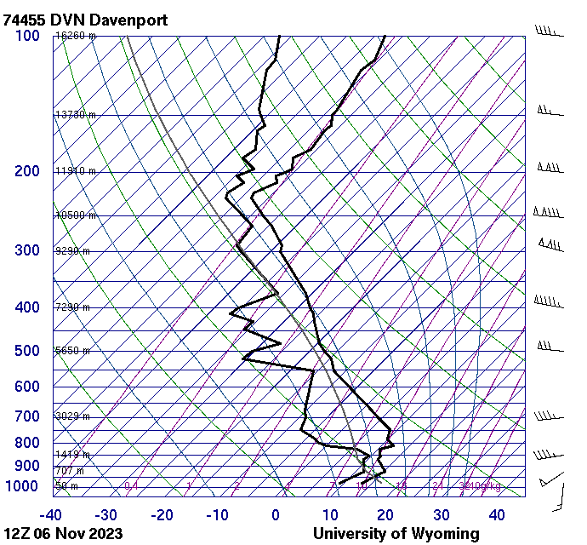

Slide 10
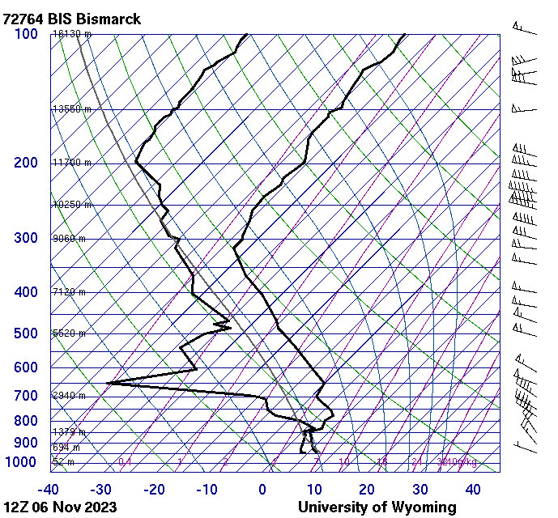
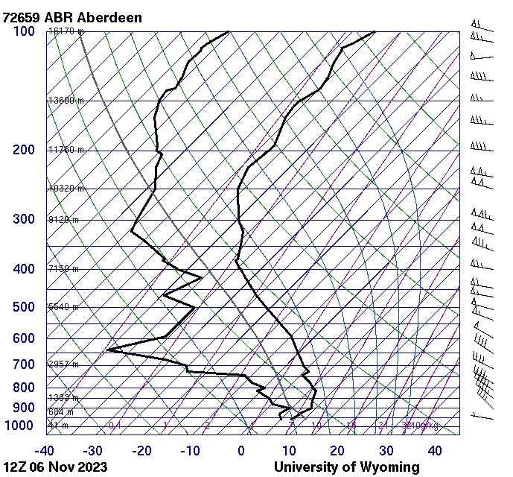

Slide 11
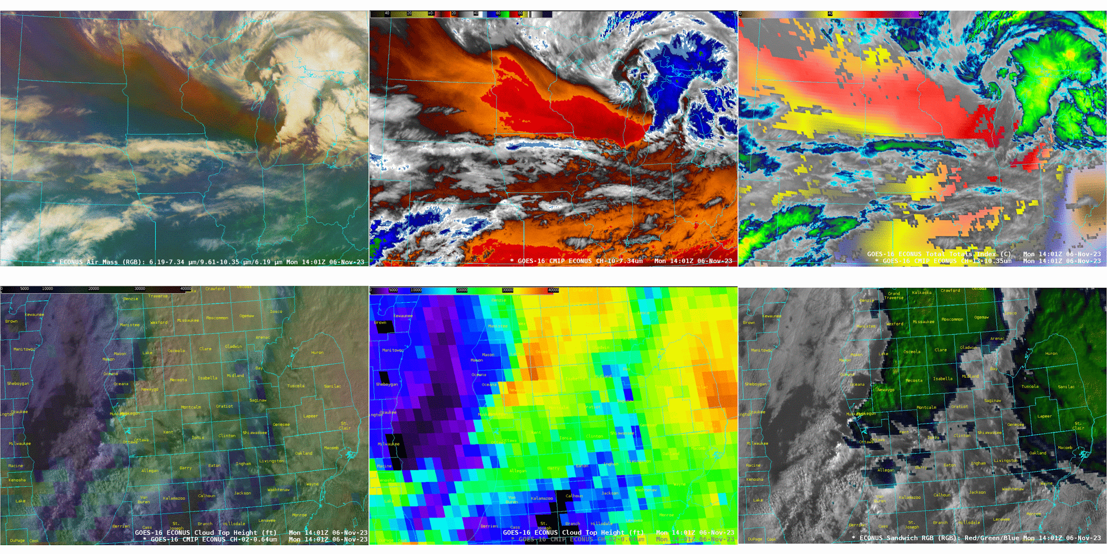
Airmass RGB
CH10 Lower WV
IR/ Total Totals
Cloud Top / Vis
Cloud Top Height
Sandwich

Slide 12
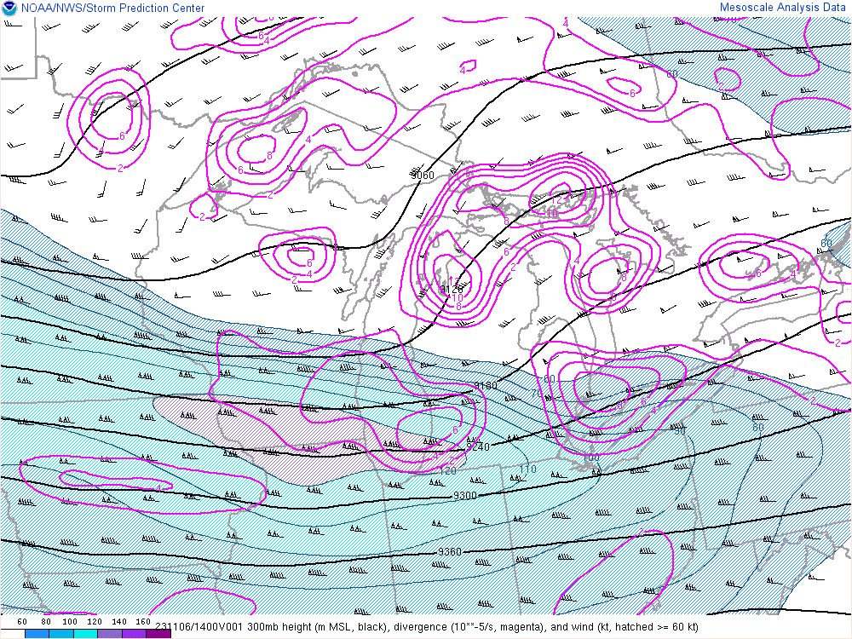
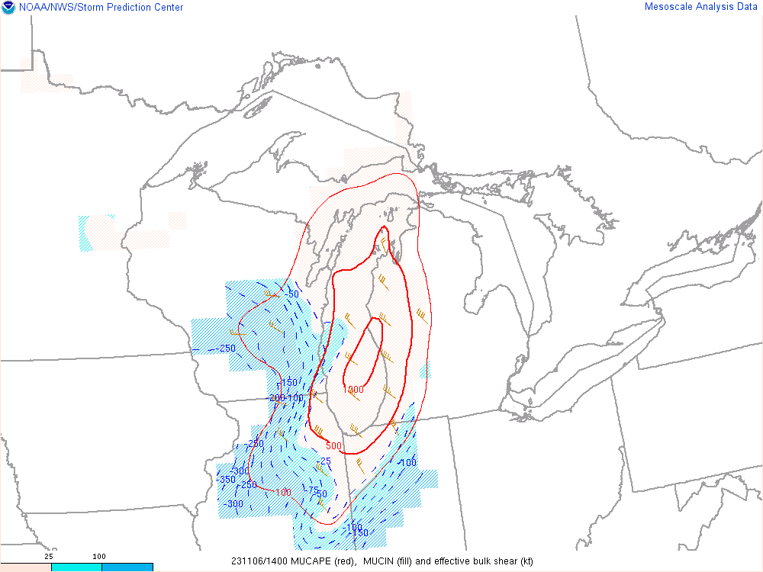
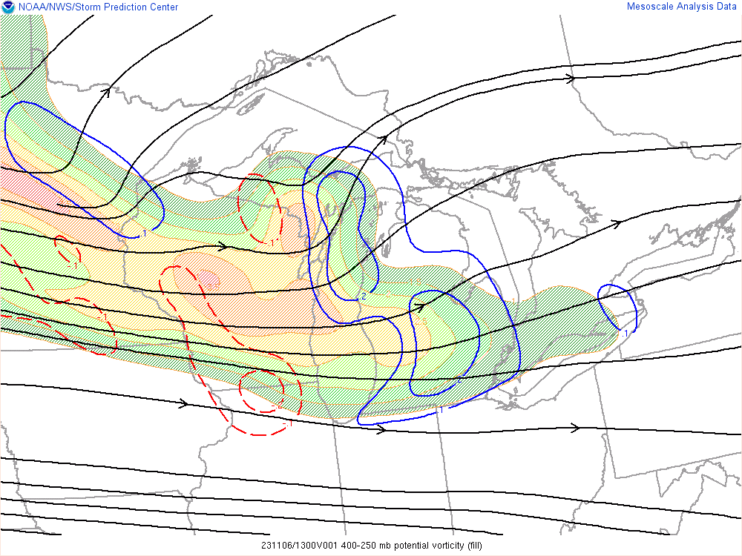
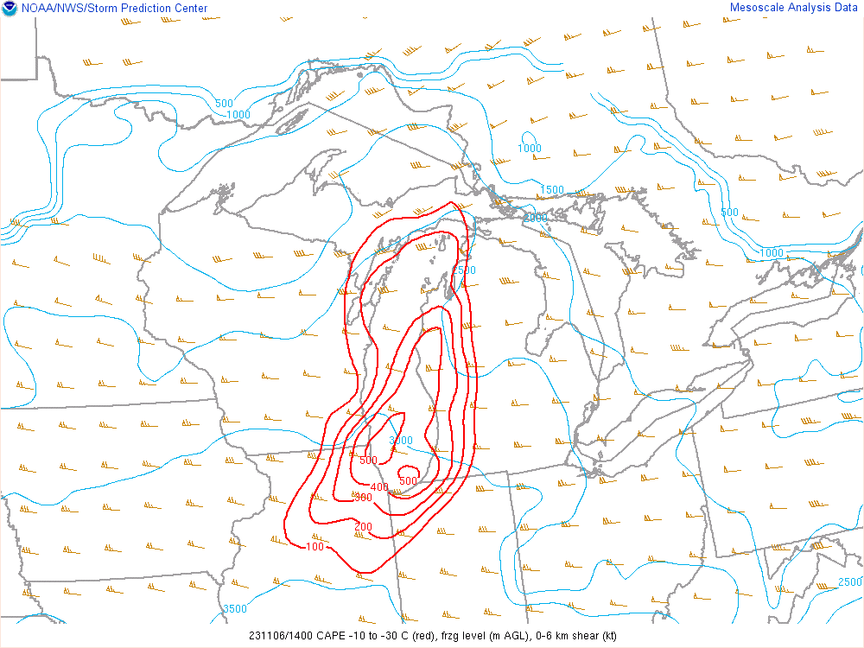
SPC Mesoanalysis
300mb
hght/wind/div
MUCAPE
Eff shear
400 - 250mb
PV / PV adv
-10 to -30C CAPE
0-6km shear

Slide 13
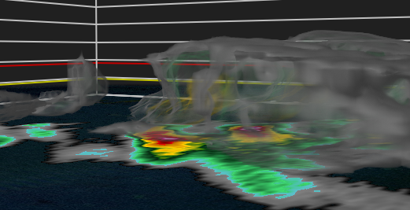
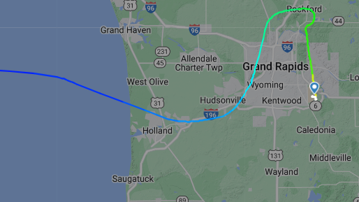
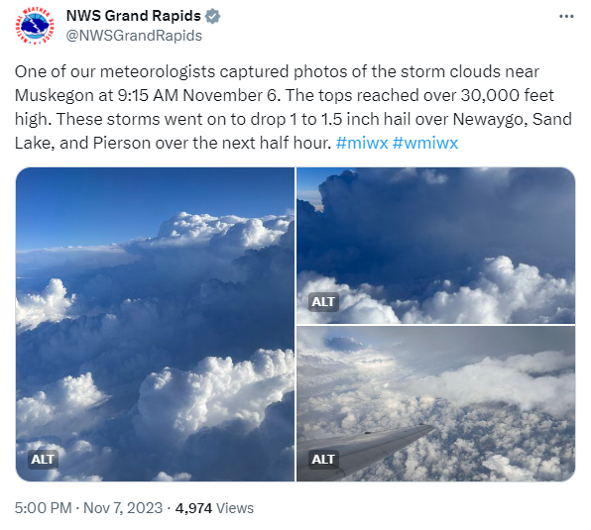
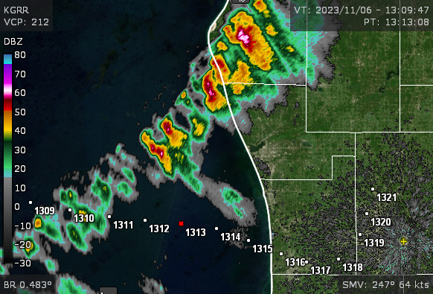
A Fortuitous Flight Home …

Slide 14
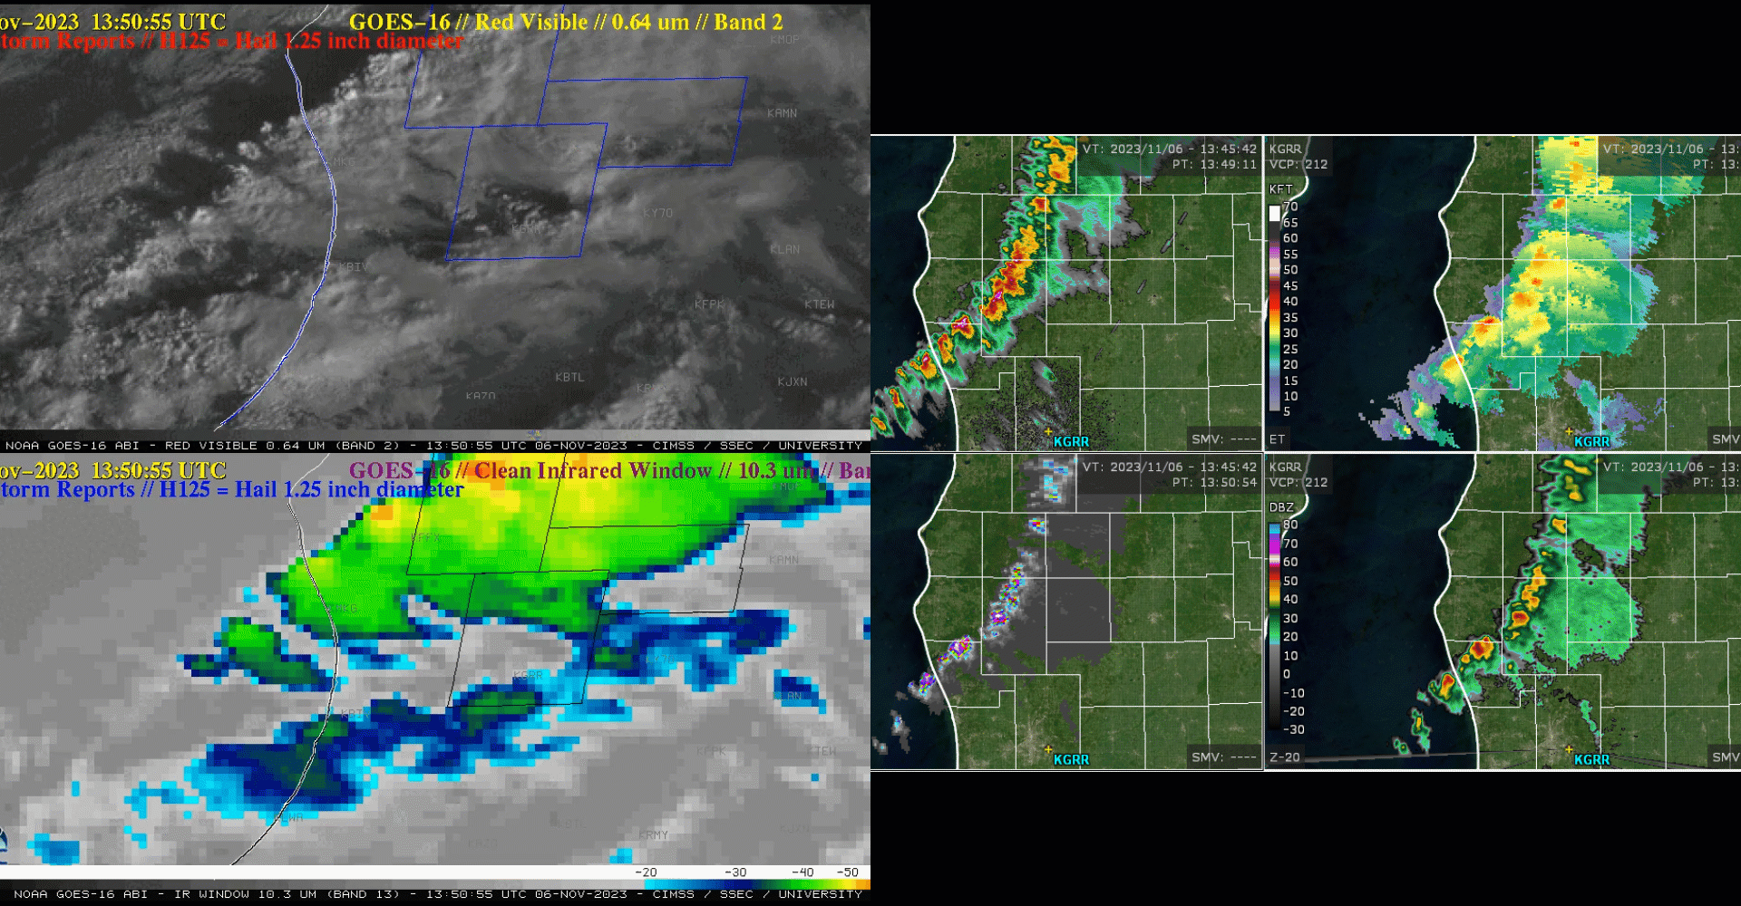
0.5 deg Z
Hgt 10 dBZ
Vert Int Ice
-20C dBZ

Slide 15
A Climatologically Rare November Morning Hailstorm in Southwest Lower Michigan: Using the Airmass RGB to Diagnose an Intense, Localized PV Intrusion
Summary
Airmass RGB excels at distinguishing … air masses!
PV Intrusions
  especially easy to detect
  if overspreading low-level moisture, increase:
    convective destabilization
    wind shear
Thank you !!
https://cimss.ssec.wisc.edu/satellite-blog/archives/55525

