Slide 1





FDTD GOES Applications Webinar
Moving Toward Situational Awareness with the Geostationary Lightning Mapper (GLM)
Presented by
Jason Jordan
NWS WFO Lubbock, TX

Slide 2
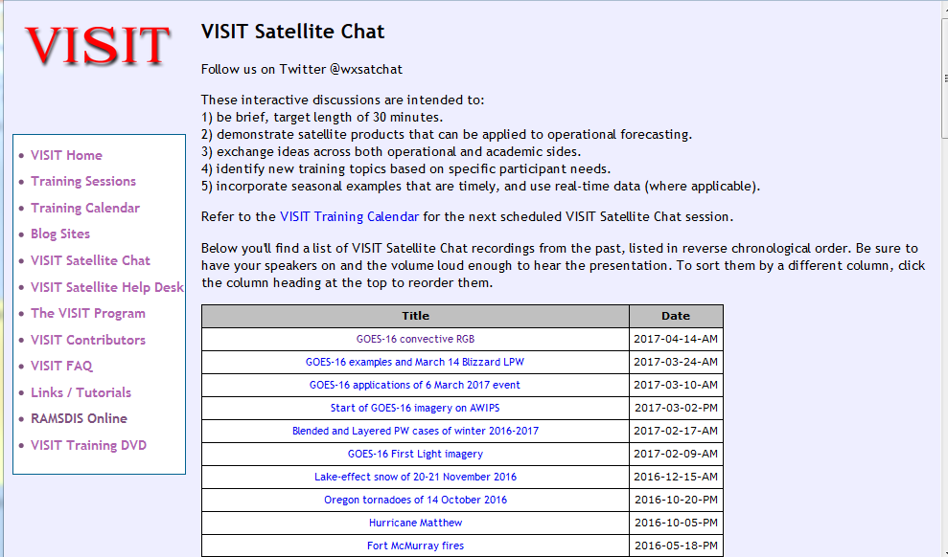
FDTD “Satellite Applications” Recorded Library
http://rammb.cira.colostate.edu/training/visit/satellite_chat/
Recorded Content includes Q&A
Call for speakers! Let us know if you want to speak on a topic!
Contact: scott.lindstrom@noaa.gov OR dan.bikos@noaa.gov

Slide 3


FDTD GOES-16 Applications
Webinar Protocol
~20 minutes for the speaker
  Send questions via GoTo Chat
  Or ask during Q&A period via phone
Followed by Q&A
  Open discussion forum
  Done by 1930 UTC
Do NOT press hold!!!
Mute when not speaking

Slide 4
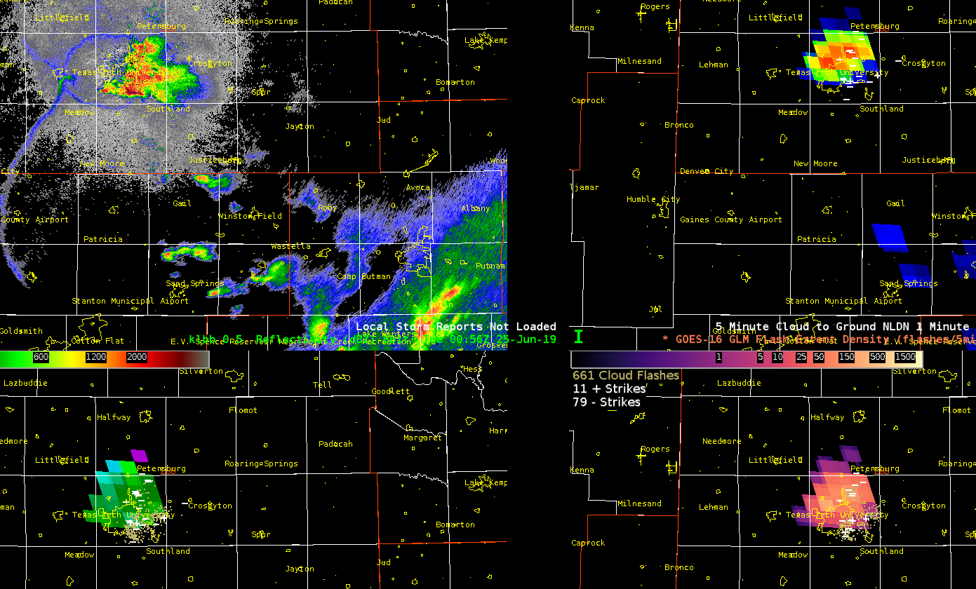
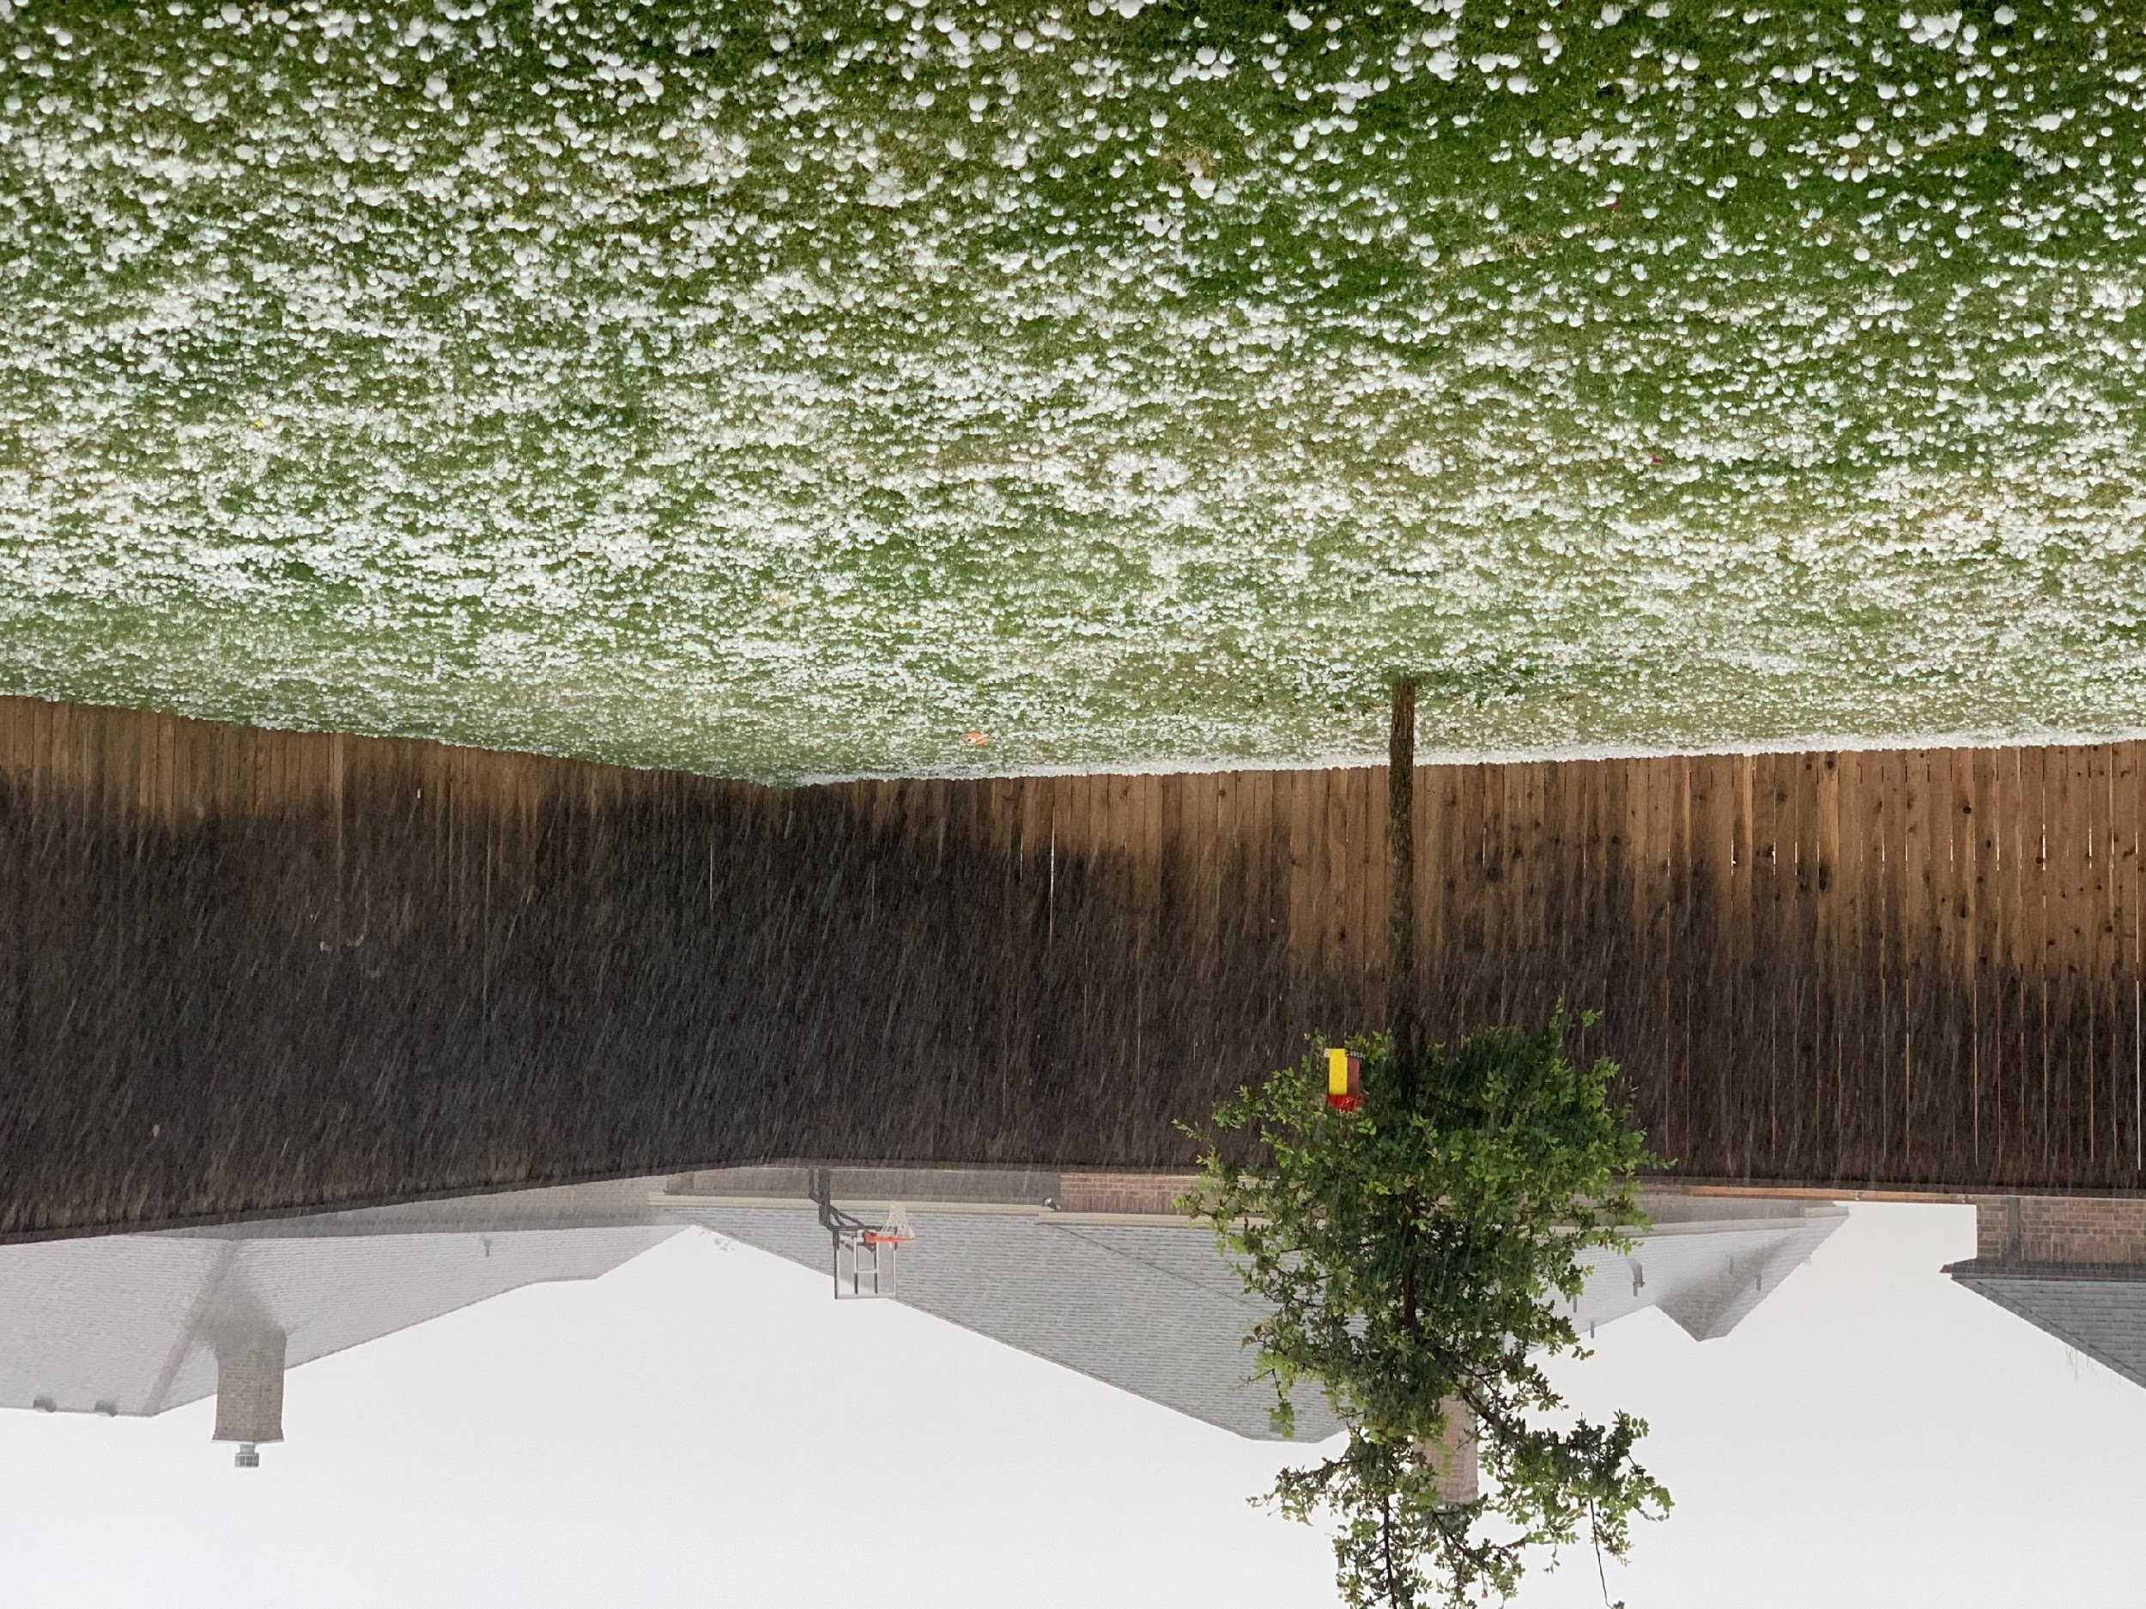
GLM at a National Weather Service Forecast Office
First Thoughts and Experiences
Jason Jordan
Senior Meteorologist
National Weather Service Lubbock, TX

Slide 5
What will be covered?
Where it all began (for WFO LUB)
  Growing Pains!!
Arrival of GLM data
  Awesome, what do we do with this now?
  This isn’t quite working like we thought…
Successes
  O2R -> R2O Collaboration
  Decision Support
  Situational Awareness
  Warning Operations Support
Final Thoughts/Conclusions

Slide 6
Your Mileage May Vary (Caveats)
Just One Viewpoint!
  122 WFOs
  21 CWSUs
  13 RFCs
  9 National Centers within NCEP (NHC, SPC, OPC, etc.)
  6 Regional Operation Centers
  And so on!
We were/are ahead of the game
Easy Access to GLM Knowledge
Notes:
All this to say that we are lucky to have the opportunity to work closely with many research partners working on/with the GLM so my take on things may not be representative of other offices in the NWS!

Slide 7
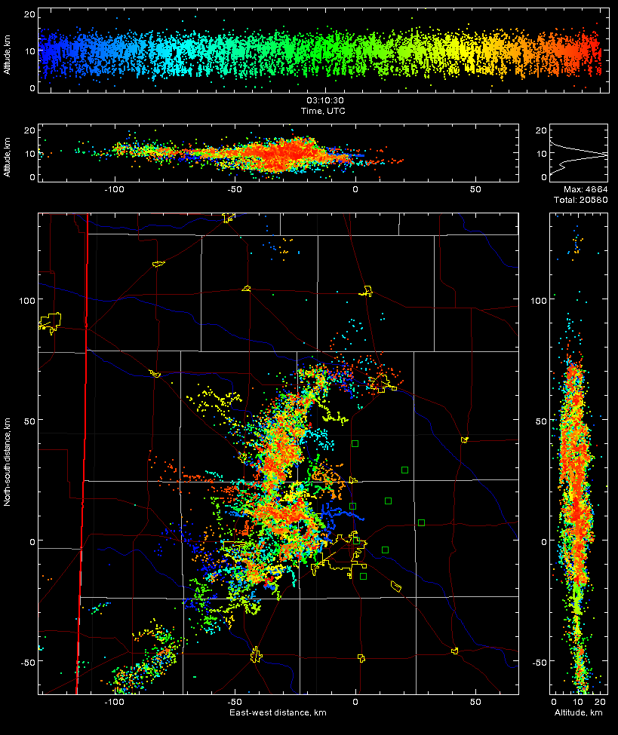
Where it all Began (West Texas LMA)
Notes:
The West Texas LMA arrived in 2012 and WFO Lubbock was asked by Eric Bruning if we wanted access to the data. We said yes and this started the learning process. This is a case of a QLCS tornado from 2012 that may have produced a brief tornado west of Lubbock near Reese Center,

Slide 8
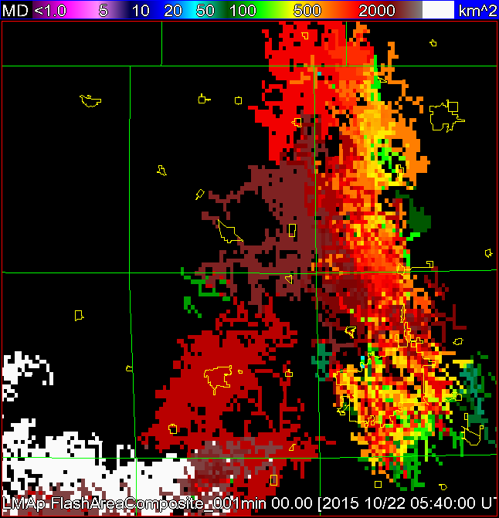
Where it all Began (West Texas LMA)
Notes:
From there as Dr. Bruning’s research continue to mature, we started trying to get data into AWIPS for operational use. The first case was all the processing to do Flash Extent Density, Flash Initiation Density, and as shown here, Flash Area.

Slide 9
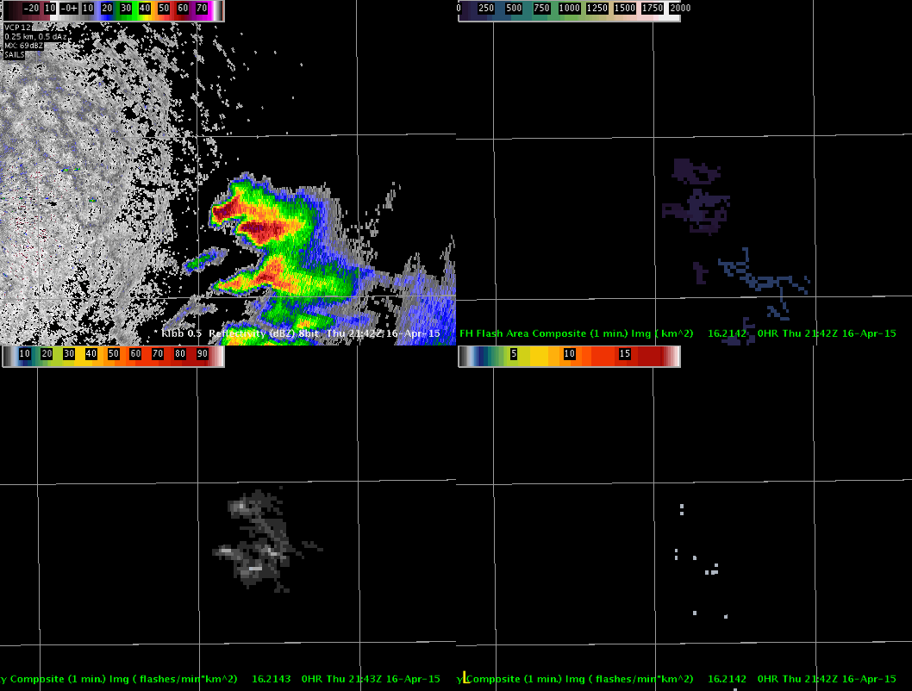
Where it all Began (West Texas LMA)
Notes:
Finally by 2015, we had the data flowing into AWIPS. Kind of. Here is a case of storms east of Lubbock on the edge of the West Texas LMA domain that were processed at NSSL, sent through Southern Region, and back to our system in Lubbock. A roundabout way of getting the data in but it worked. For a little while…

Slide 10
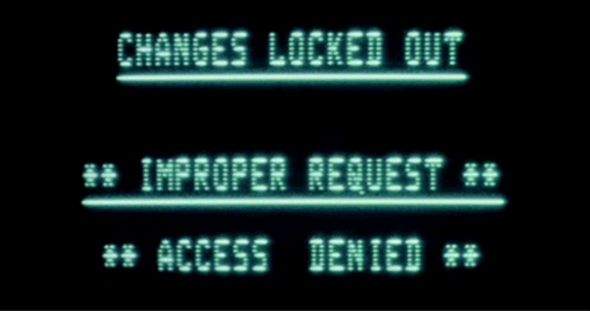
Where it (The Problems) all Began
Working during transition from AWIPS to AWIPS-II
Competing For Time
Changes were fast and furious
What would the “final” product look like?
Notes:
The problems: we were working on this ingest as we were transitioning from AWIPS to AWIPS-II. The only system that could ingest the data was in the corner of the office and it was being upgrade sometimes as often as every two weeks. That meant rebuilding the ingest and display every two weeks. I was competing for time as well between normal severe weather operations, training, forecasts, etc. We also didn’t know what the final product would look like either…remember the first Raytheon attempt?

Slide 11
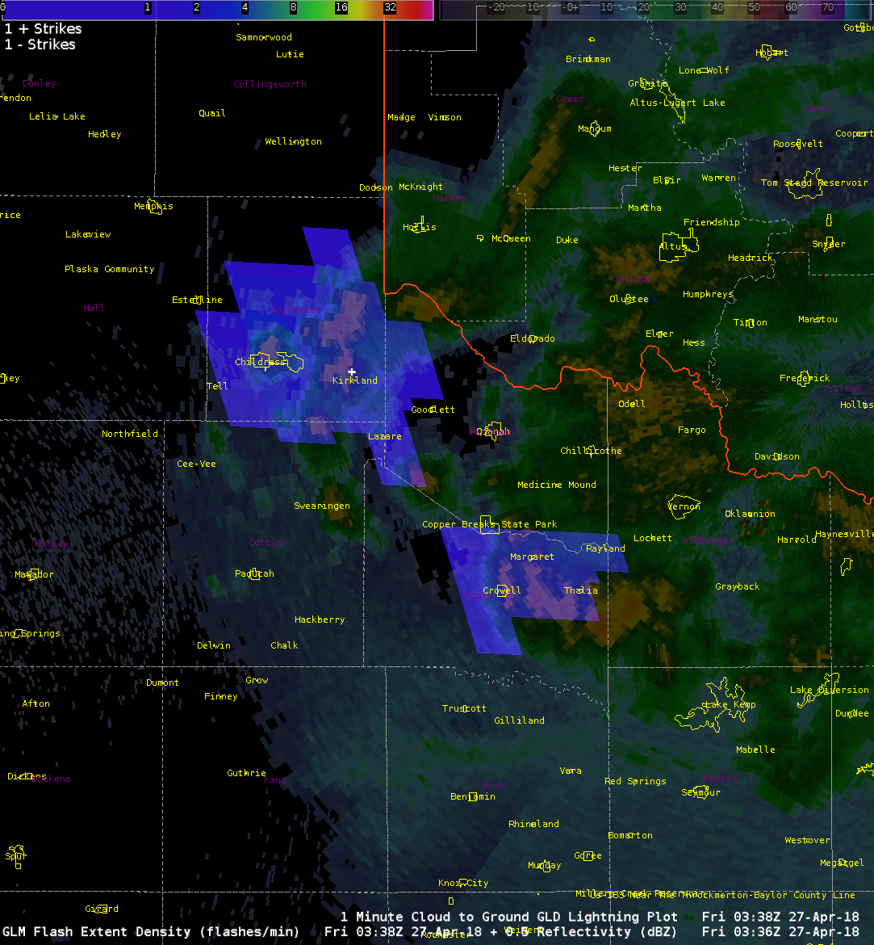
GOES-R to GOES-16
Notes:
But the data finally did arrive! This is the first image we did get after we successfully implemented the TOWR-S rpm package. And then our weather shut down

Slide 12
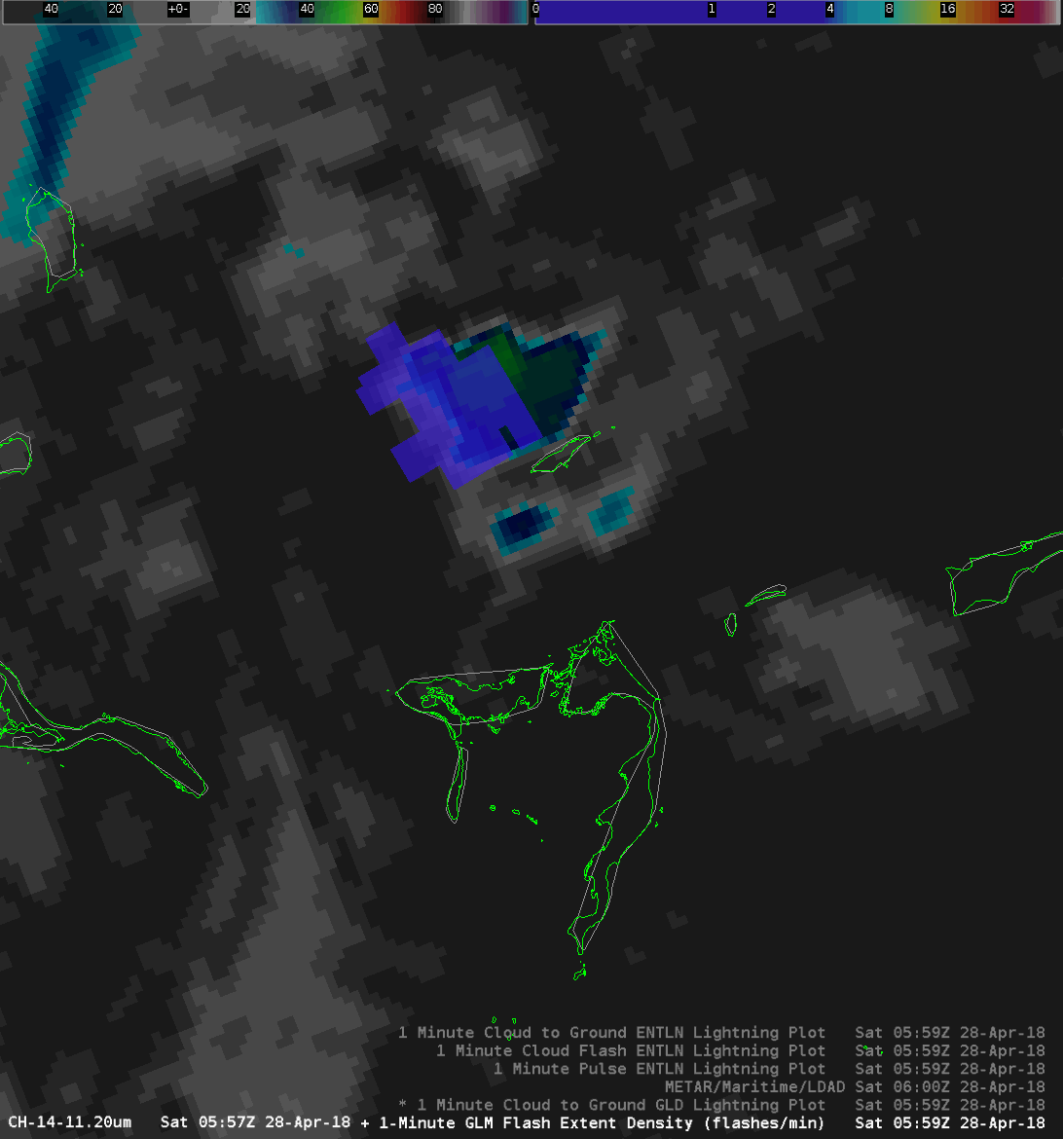
GOES-R to GOES-16

Slide 13
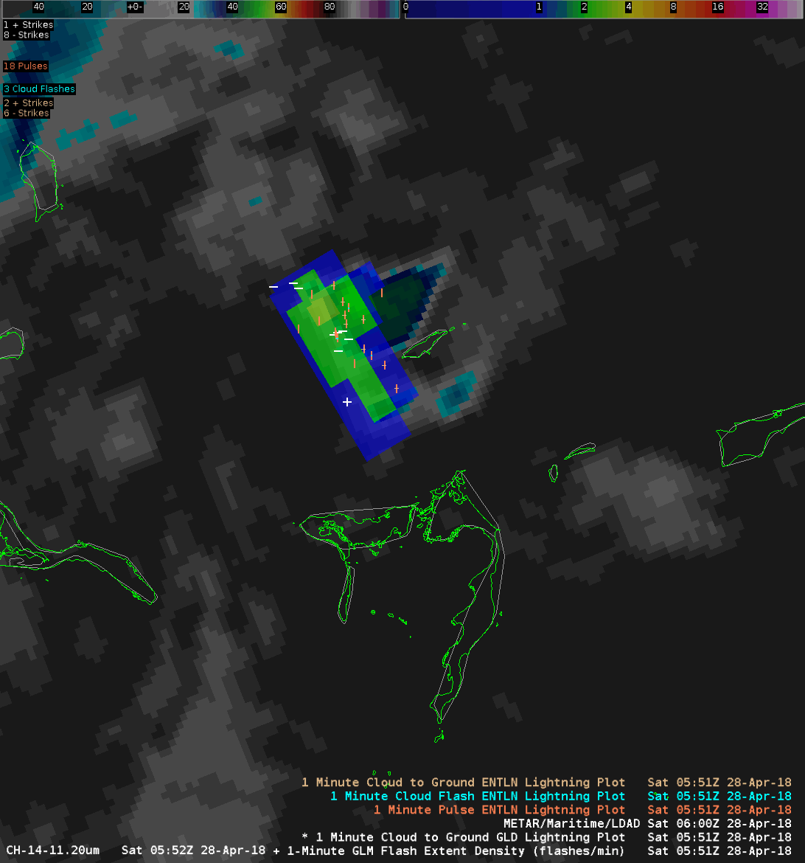
GOES-R to GOES-16

Slide 14
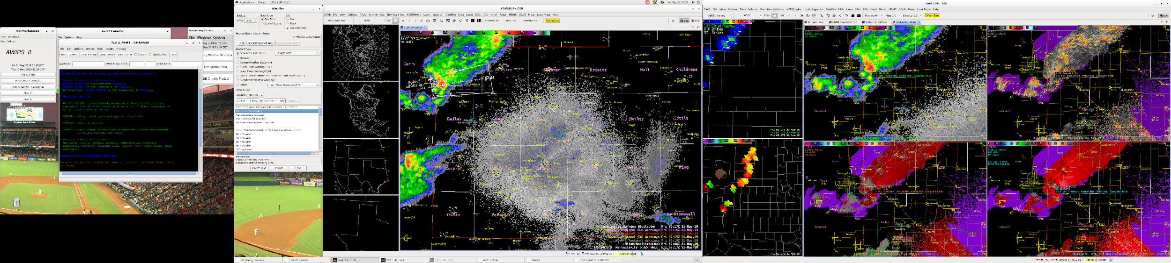
Difficulties with Display
19” “Text” Monitor 27” Graphic Monitor 27” Graphic Monitor
Some of the AWIPS/system issues:
Graphic data is a memory hog
Too much display data and CAVE becomes unstable
Overlays what, when, where, how…
Data Delivery Issues
Some of the user issues:
“I don’t want to crash my system.”
“Where can I overlay this to give me what I need?”
“That looks pretty neat but I don’t need it”
Notes:
One main issue was how to display the data. Screen “real estate” may not seem limited but it is; we can’t have too many windows open with lots of data or the system becomes unstable. How do we best display the data? Overlays, stand-alone, time match to what? Users in our office had more questions and were generally unwilling to use the GLM data at first.

Slide 15
Difficulties with Display

Slide 16
Difficulties with Display

Slide 17
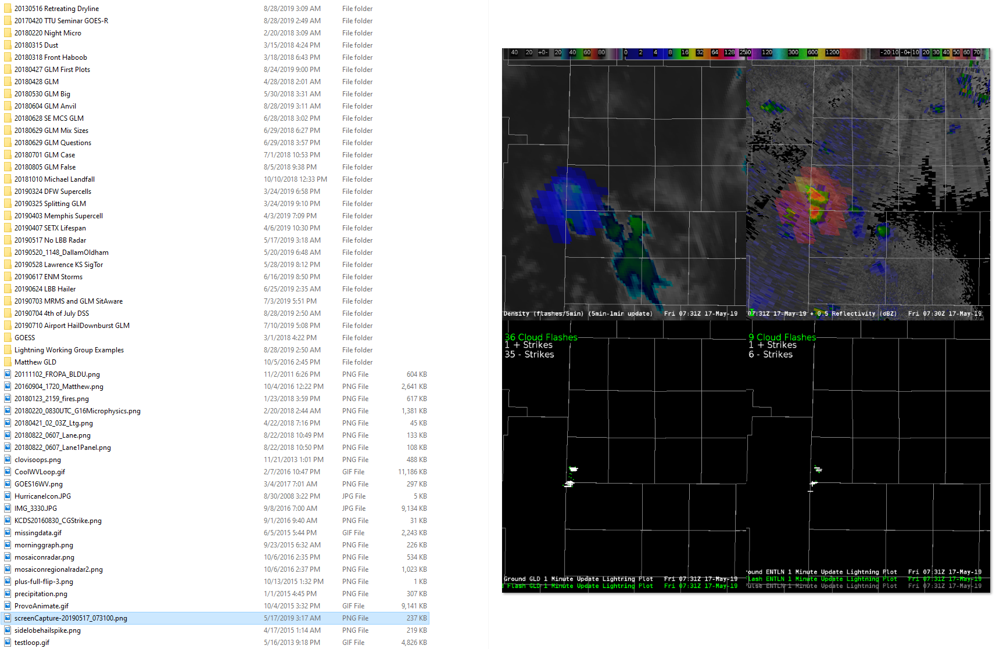
Difficulties with Archiving
Notes:
There are also a lot of things to look at and often-times need to be viewed post-event. Archiving becomes an issue because of the amount of data that we have and how selective we need to archive. I got in trouble with our ESA and ITO because I had 2.5 GB worth of imagery, loops, and examples of mostly GLM cases to remind me of what I’m looking at!!

Slide 18
Success with Implementation
Notes:
BUT! Just look at all the examples I’ve pulled off! Almost all of these cases I have pulled off have been used to teach, have been used in operations, or are of events outside of our forecast area that I can use to help train others.

Slide 19
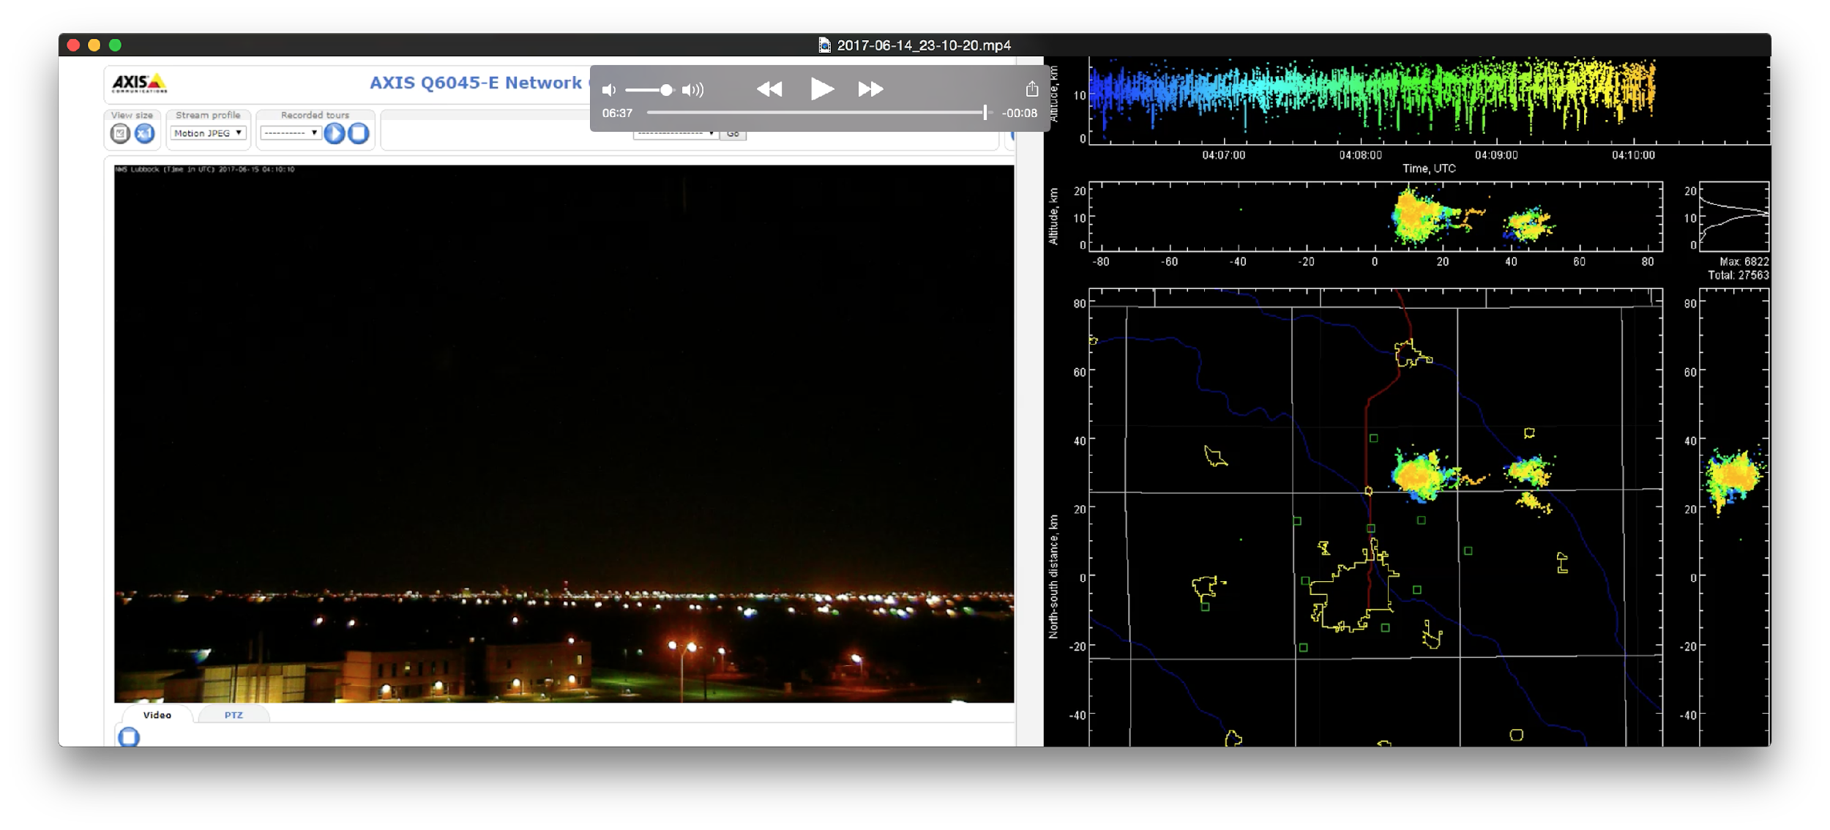
Success with Implementation
Notes:
Here is an operations to research case; this was right after the GLM data started flowing in the evaluation phase. We had a storm pop up north of our office that was producing a LOT of lightning and we took video of this while comparing it to the LMA. Turns out that we caught this CG flash out the north side of the storm and Dr. Bruning went back and found that it did not show up in the GLM data.

Slide 20
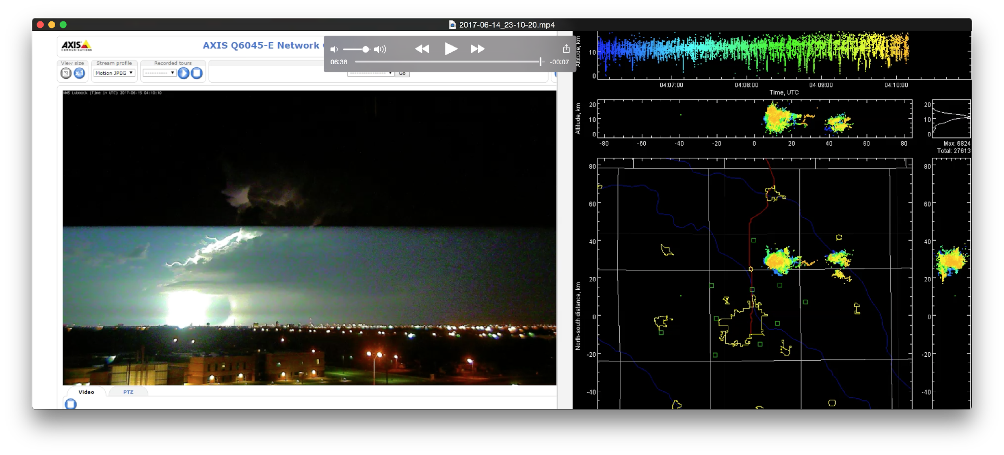
Success with Implementation

Slide 21
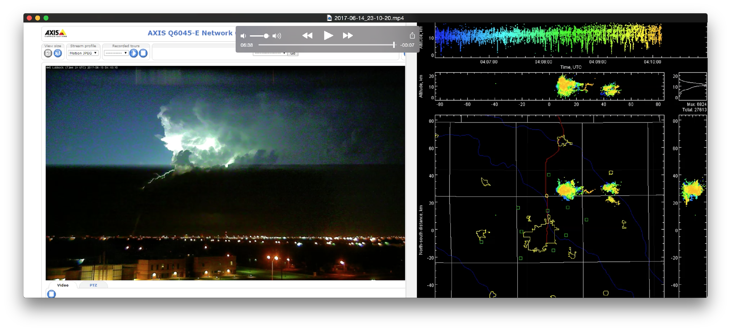
Success with Implementation

Slide 22
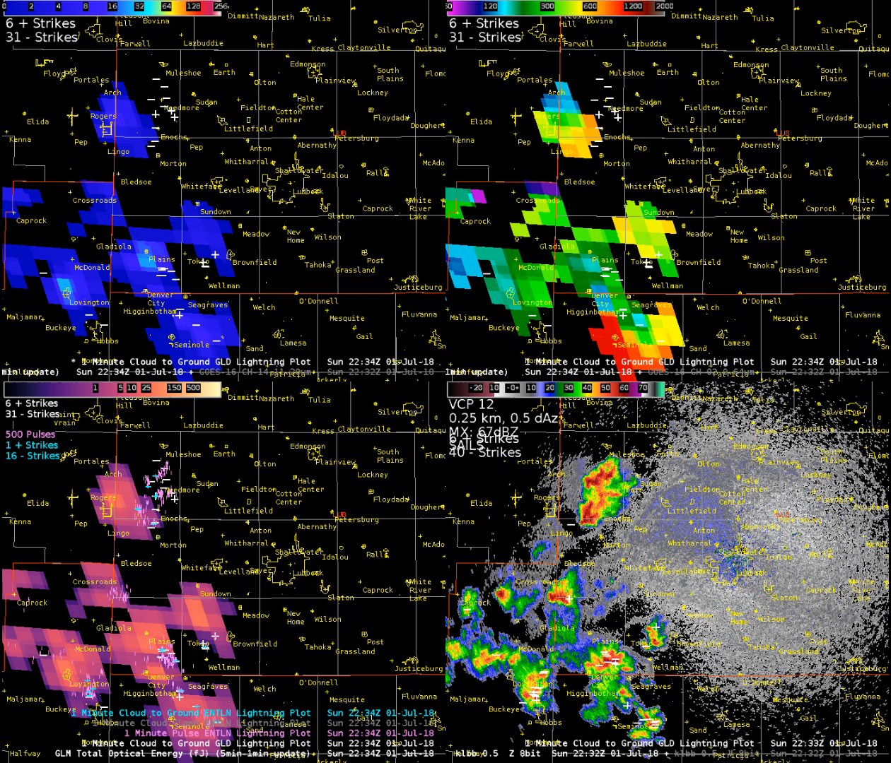
Success with Implementation
Notes:
This was a good case for us because it gave many forecasters the chance to see the transition of cellular convection into a weak line. Flash area transitioned to

Slide 23
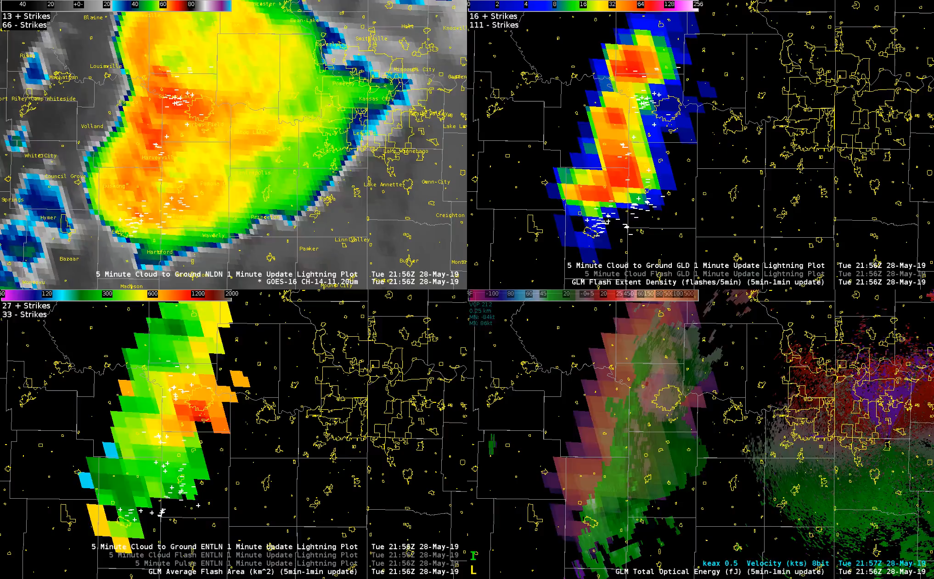
Success with Implementation

Slide 24
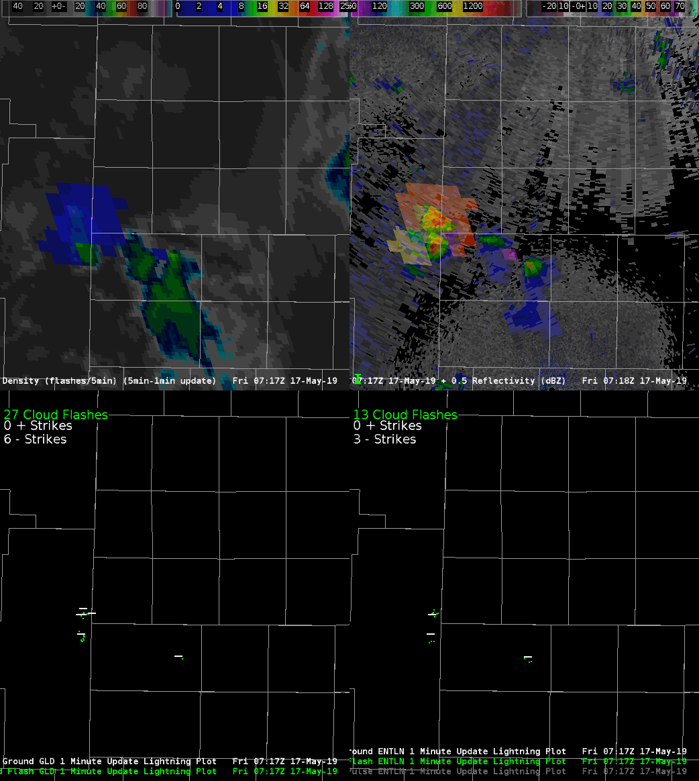
Success with Implementation

Slide 25
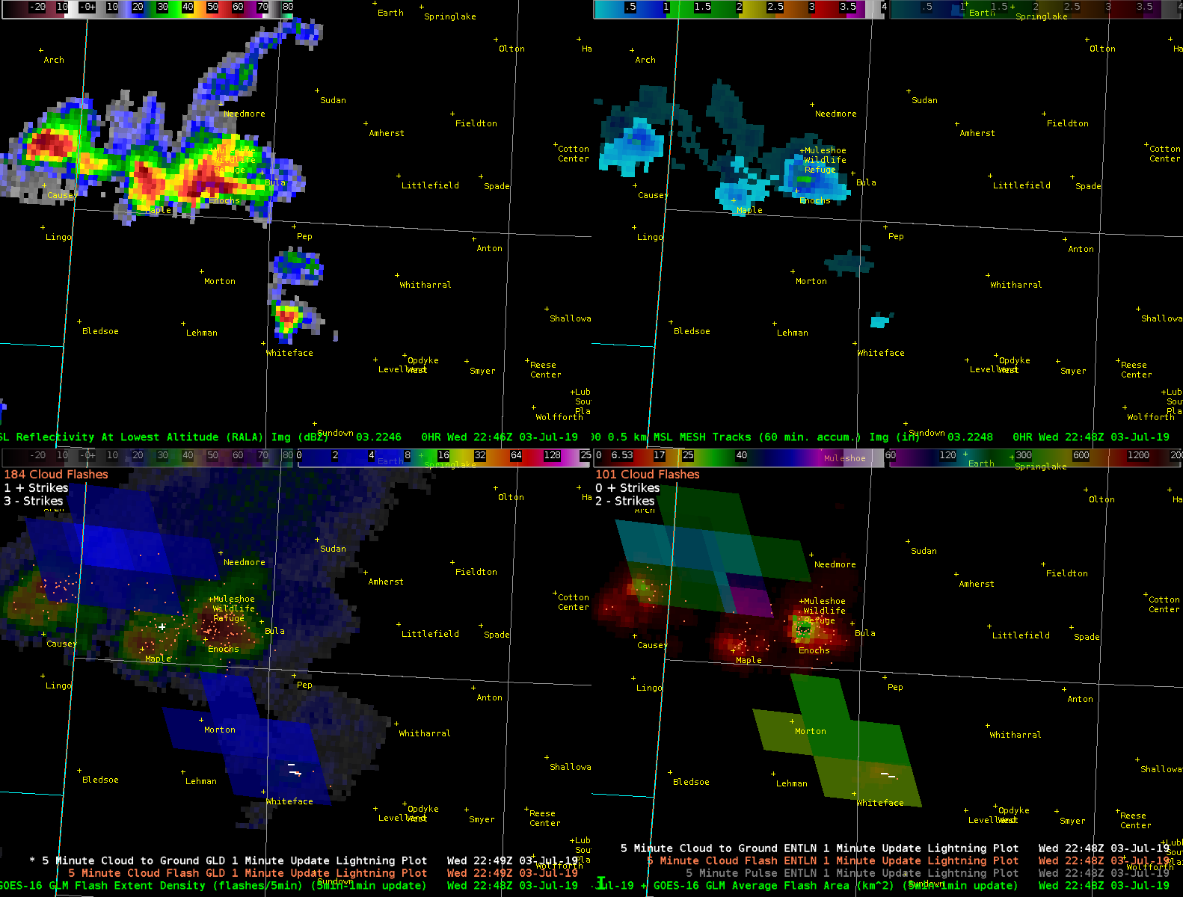
Success with Implementation

Slide 26
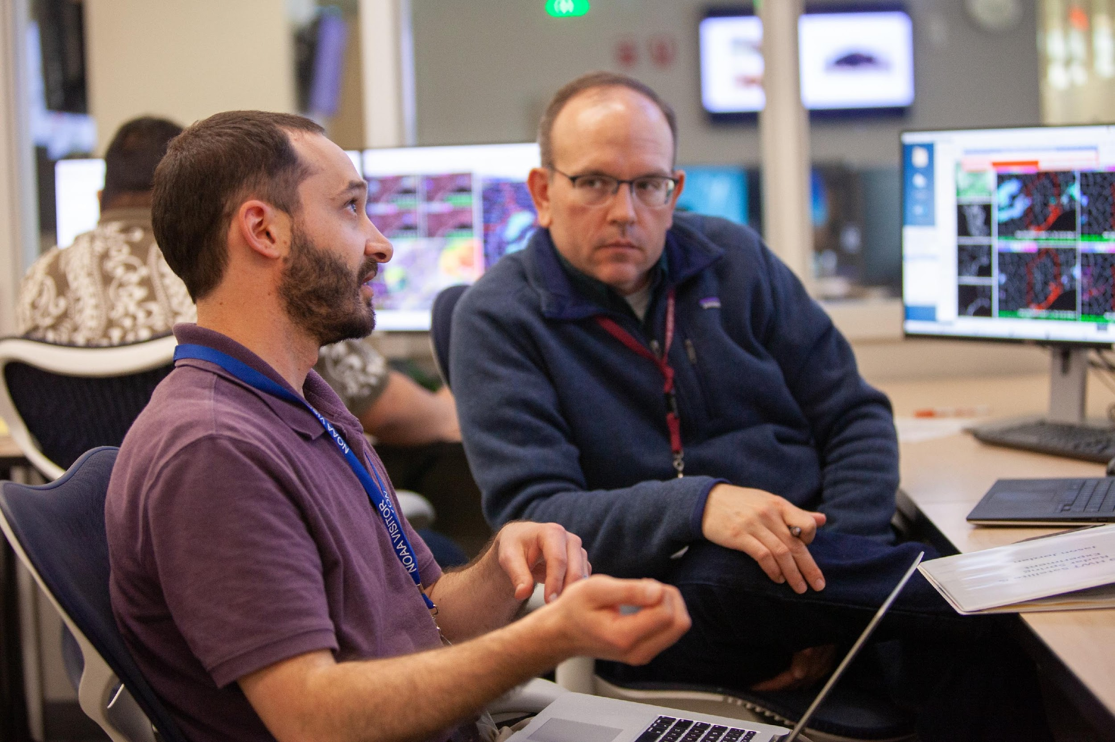
Conclusions and Final Thoughts
It is taking time but we are getting there…
  More cases, more understanding, more use!
Workload and data overload
  How to achieve balance?
Stay involved.
  R2O -> O2R
Stay accessible, friends!
  Tools, archives, notebooks, data

Slide 27
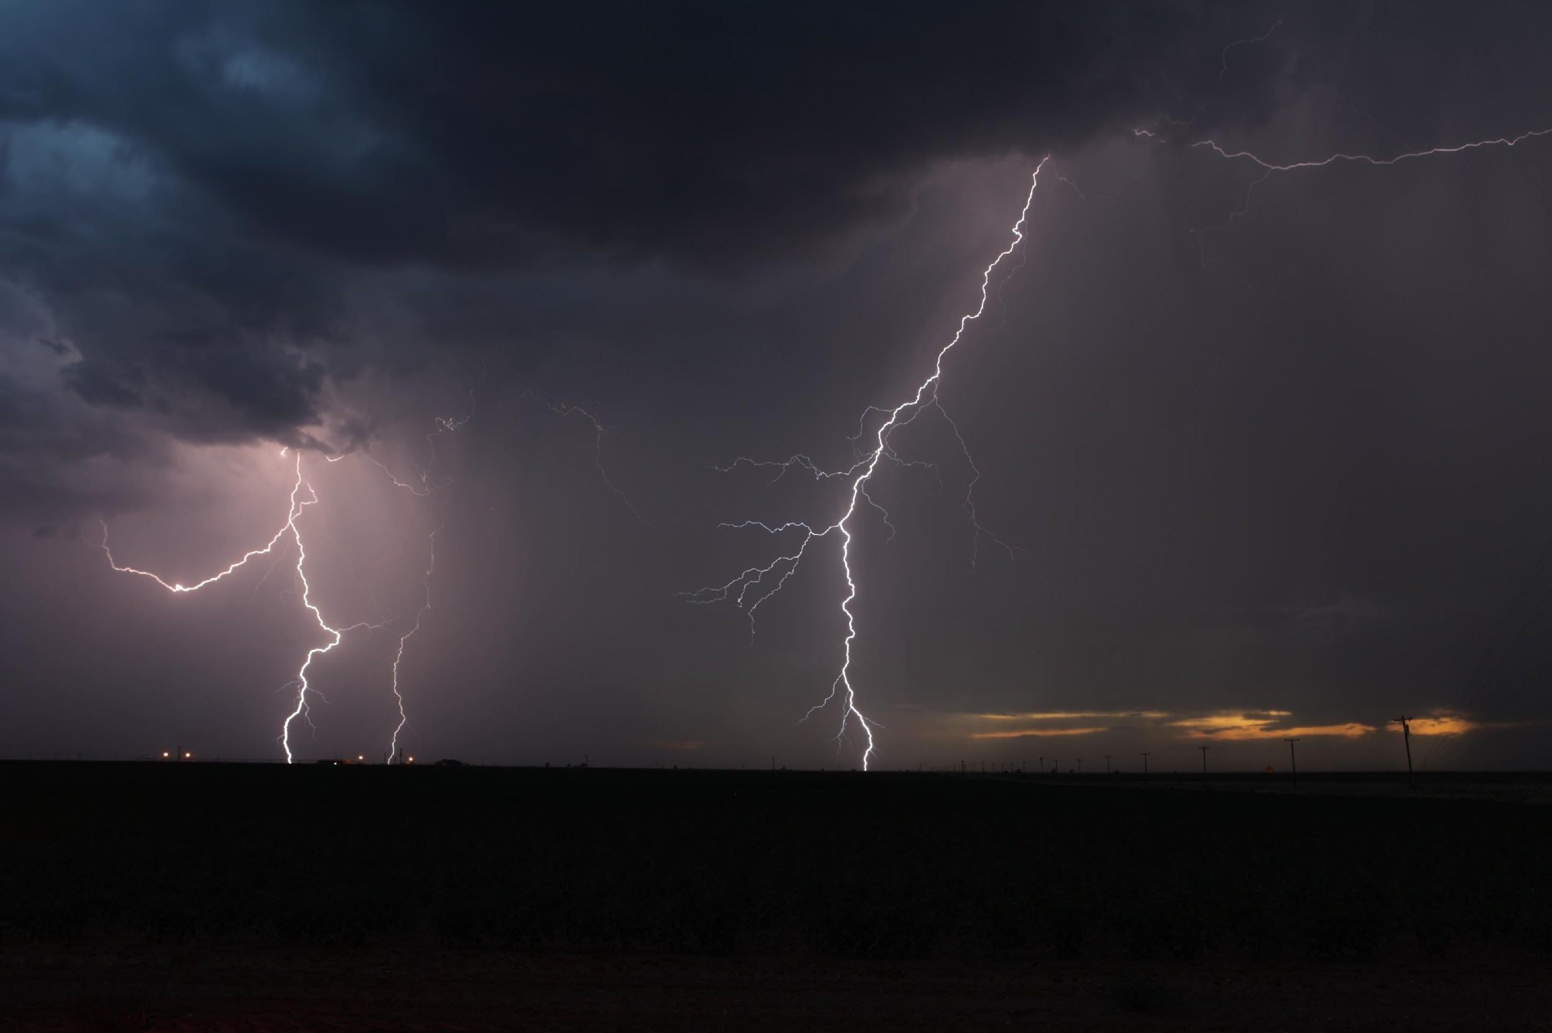
Questions?
Jason.Jordan@noaa.gov Twitter: @kc5knd

